Slide 1
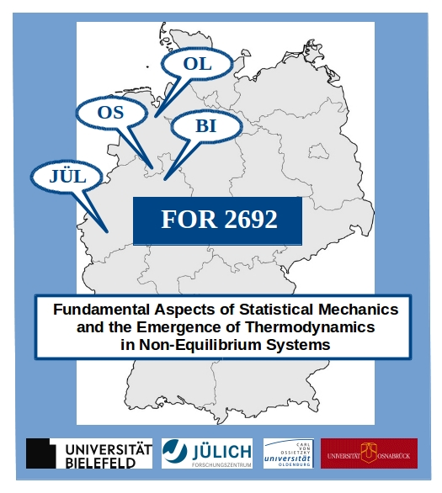
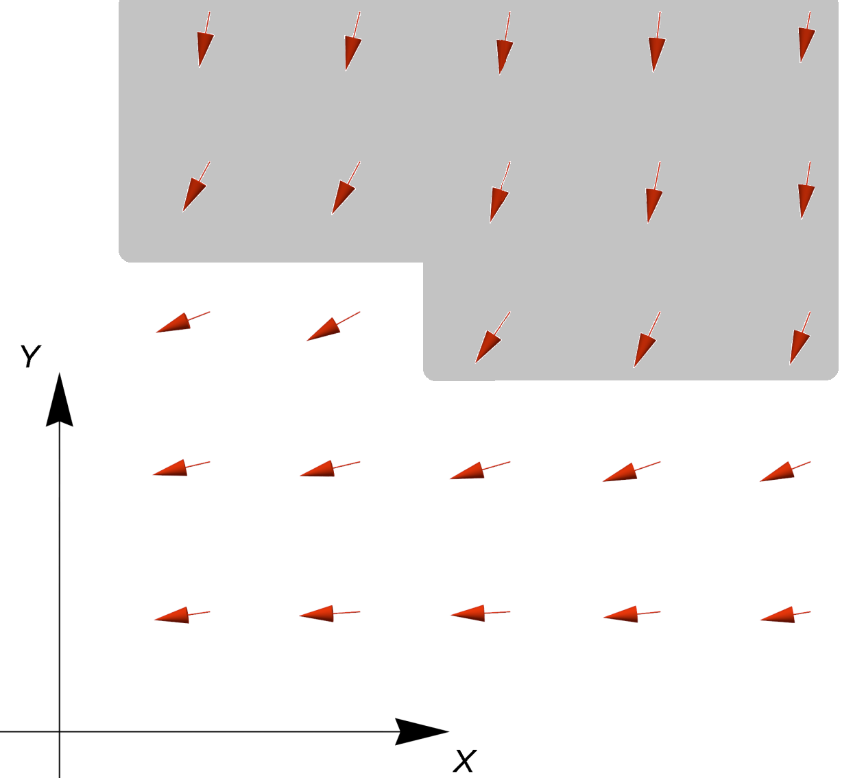
Non-equilibration and synchronization in isotropic Heisenberg models Jürgen Schnack, Patrick Vorndamme, Peter Reimann Bielefeld University, Bielefeld – Germany
For SU(2)-symmetric Hamiltonians such as the Heisenberg Hamiltonian
Total spin S and total magnetic quantum number M are conserved,
Time-evolution can be written as Fourier series in $ΔM≡ν$
Under reasonable and typical conditions Fourier components equilibrate
Perfect synchronization of equivalent
observables, also of higher order in $s_{i}^{±}$
&
persistent periodic oscillations

